Slide 1
Income Prediction

Slide 2
Objective:
Income Prediction Application is tool developed for intention to support traders in decision making before placing final order in the stock market. Income Prediction application predicts the trend of particular stock based on past 100 trading session prices. Benefits:
Detect trend of stock.
Can aid in decision making for traders
Uses past data from trend prediction

Slide 3
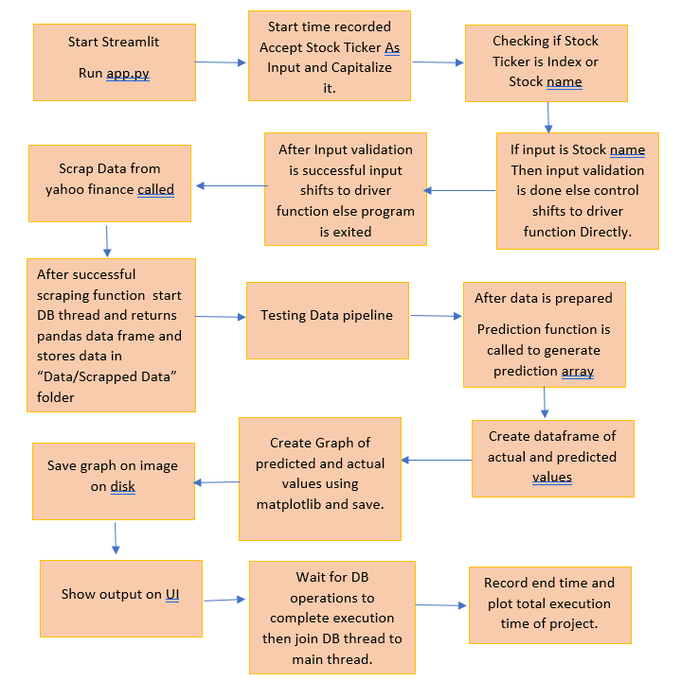
Architecture:

Slide 4
Input Validation & Data Transformation:
Entire project flow depends on the input entered by user, User input is valid stock symbol. If input name is invalid, there is no point in moving forward. Input is validated by checking that whether it exist in EQUITY.csv file which consist of all stock’s symbols or is it the index name i.e., Nifty or Bank nifty.
After input is validated, scraping is done, and data is saved to csv file in target folder in format “SYMBOL_NAME.CSV” . Dataset is checked for condition that it should contain more than 100 rows.
All columns from scrapped data are not important, out of all we must have price, date, and volume columns. And, out of these 3 columns only price column is important for prediction. Data and volume column is for future improvements.

Slide 5
Data Insertion in Database :
We use price data to predict future trends in stock markets, scraping is resource consuming process and the data scraped has to recorded somewhere as this is standard Operating procedure (SOP) of project.
Tabular data consisting Prices, Volumes and dates is logged in to remote databases.
Cassandrea remote database is used. Cassandrea database has an hierarchical structure. 1st layer is Database, 2nd layer is key space, 3rd layer is table names.
We have used “test1” database and “demo” keyspace to store tabular data to remote Db. Inside “demo” keyspace we data is stored in multiple tables with table name in format “STOCKNAME.CSV”
To know the table and keyspace names, we have created mechanism to log details in format “keyspace_name.table_name”, which can help one to fetch data of stock from remote DB.

Slide 6
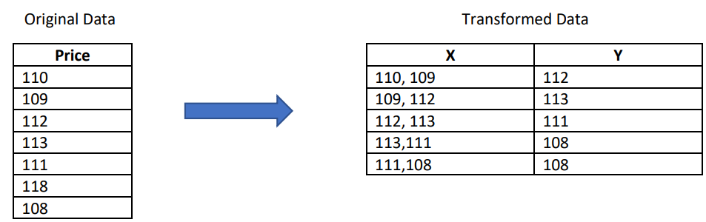
Model training:
LSTM stands for long short term memory, LSTM works well for time series analysis
Csv Dataset is transformed in order to train model
Special Training pipeline is developed to transform data to enable model training.

Slide 7
Model training:
Trained Model is saved in h5 format
This model accepts array of numpy array to make predictions
Each predicted value is based on historic price data of last 100 training session.

Slide 8
Prediction:
After successful training the model it’s important to fed data in appropriate format to get predicted prices, which will eventually help us to predict the trend
Scraped data is passed from testing pipeline which transforms the data in format equivalent to format used for training the model.
One can refer to below image to the transformation of data before feding it to model for prediction.

Slide 9
Prediction:
After successful transformation of data, scaler is loaded which transforms the data.
This scaled and transformed data is fed to prediction function.
Prediction function generates values and these values are scaled up.
These scaled up predicted values are final prediction.
These final predictions are compared against original values.

Slide 10
Q & A:
Q1.) What is Data Source ?
Data is Scraped from yahoo finance website.
Q2.) What is type of data ?
Data is scraped in pandas data frame and saved to .csv file formate. Data consit 3 columns.Price(Float), Volume, (Float) Date (String).

Slide 11
Thank You !

